Slide 1





JQuery Plugins
Sliders, Date & Time pickers, Form Validators, Drag’n’Drops
JavaScript for Front-End
SoftUni Team
Technical Trainers
Software University
http://softuni.bg

Slide 2








Table of Contents

Slide 3
Have a Question?
sli.do #front-end

Slide 4

Slick Slider

Slide 5
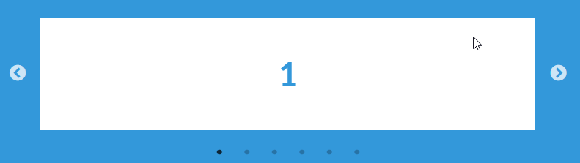
Slick Slider
A simple slider plugin which enhances the user experience
Fully responsive. Scales with its container.
Uses CSS3 when available. Fully functional when not.
Desktop mouse dragging. Infinite looping.
Documentation: http://kenwheeler.github.io/slick/

Slide 6

Slick Slider (Demo)
<head>
...
<link rel="stylesheet" href="css/style.css">
<link rel="stylesheet" href="css/slick.css">
<link rel="stylesheet" href="css/slick-theme.css">
<script src="lib/jquery-3.3.1.min.js"></script>
<script src="lib/slick.js"></script>
</head>
The plugin CSS
JQuery & the plugin
Our Slider and its slides
<body>
<div class="slider">
<div class="slider-element slider-element-first">First</div>
<div class="slider-element slider-element-second">Second</div>
<div class="slider-element slider-element-third">Third</div>
</div>
</body>

Slide 7
Slick Slider (Demo) – Result
<body>
<div class="slider">
...
</div>
<script src="app.js"></script>
</body>
Import your JavaScript file
app.js
Calling the slick() function initiates the plugin functionality
Result...
$('.slider').slick();
Select the element, using JQuery

Slide 8

Slick Slider
Live Demo

Slide 9

Date & Time Picker

Slide 10
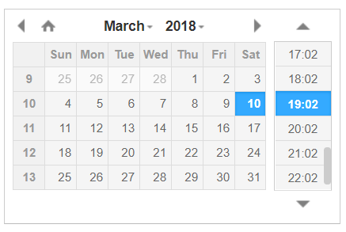
Date & Time Picker
DateTimePicker is a very basic plugin which customizes date input in forms
Simplistic, but contains many options
Easily customized
Configurable for Date pick only
Configurable for Time pick only
Configurable Time interval
Documentation: https://xdsoft.net/jqplugins/datetimepicker/

Slide 11

Date & Time Picker (Demo)
<head>
...
<link rel="stylesheet" href="css/style.css">
<link rel="stylesheet“ href="css/jquery.datetimepicker.css">
<script src="lib/jquery-3.3.1.min.js"></script>
<script src="lib/jquery.datetimepicker.full.js"></script>
</head>
The plugin CSS
JQuery & the plugin
Our Form
<body>
<form class="date-time-form">
<div class="name-group">...</div>
<div class="datetime-group">...</div>
<div class="button-group">...</div>
</form>
</body>

Slide 12
Date & Time Picker (Demo)
<div class="name-group">
<label for="name">Product Name</label>
<input id="name" type=“text" placeholder="Name...">
</div>
Out datetime field group
<div class="datetime-group">
<label for="producedOn">Produced On</label>
<input id="producedOn" type="text" placeholder="Date & Time...">
</div>
Notice that it is type – “text”
<div class="button-group">
<button class="date-time-form-submit">Submit</button> </div>

Slide 13

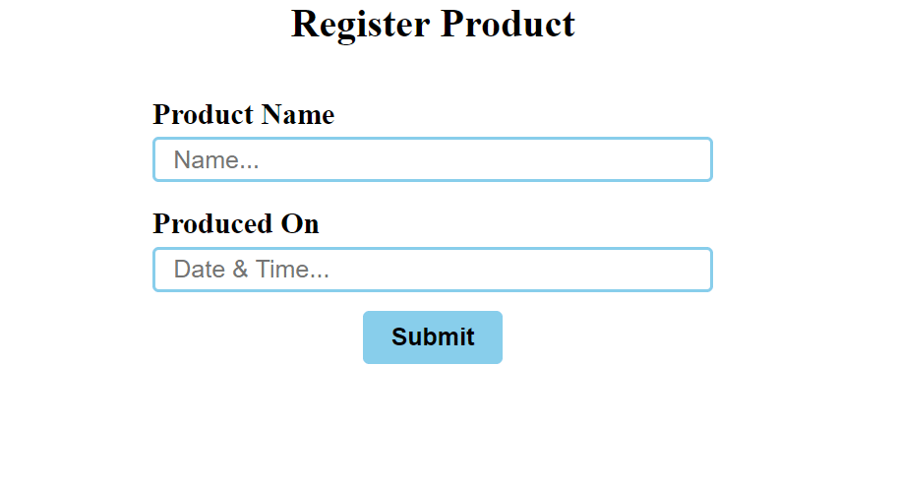
Date & Time Picker (Demo) – Result
<body>
<form class="date-time-form">
...
</form>
<script src="app.js"></script>
</body>
app.js
Don’t forget to import your JavaScript file
$('#producedOn').datetimepicker();
Select the element, using JQuery
Calling the datetimepicker() func. initiates the plugin functionality

Slide 14
Date & Time Picker
Live Demo

Slide 15

Form Validator

Slide 16
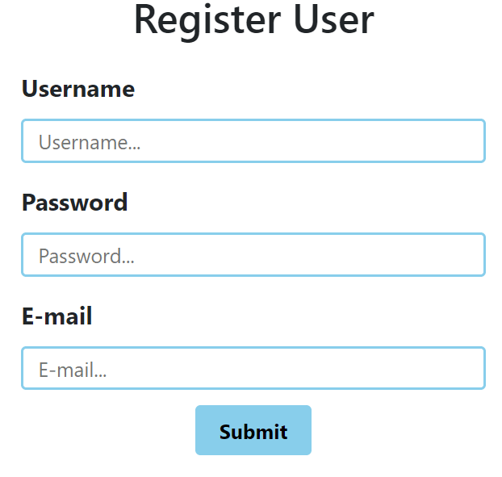
Form Validator
jQuery Form Validator is a jQuery plugin that makes it easy to validate user input
Feature-rich and multilingual.
Keeps your HTML markup clean from JavaScript.
Functionality is grouped-up in modules.
Optimized network traffic.
Documentation: http://www.formvalidator.net/

Slide 17

Form Validator (Demo)
<head>
...
<link rel="stylesheet" href="css/style.css">
<script src="lib/jquery-3.3.1.min.js"></script>
<script src="lib/jquery.form-validator.min.js"></script>
</head>
JQuery & the plugin
Our Form
<body>
<form class="validator-form">
<div class="username-group">...</div>
<div class="password-group">...</div>
<div class="email-group">...</div>
<div class="button-group">...</div>
</form>
</body>

Slide 18
Form Validator (Demo)
The data validation functionality is configured by the input fields’ meta attributes.
The plugin has its own way of interpreting them.
<div class="username-group">
<label for="username">Username</label>
<input id="username" type="text" placeholder="Username..."
data-validation="length alphanumeric"
data-validation-length="3-12"
data-validation-error-msg="The username should only contain 3-12 alphanumeric characters.">
</div>
Meta attributes

Slide 19
Form Validator (Demo)
<div class="password-group">
<label for="password">Password</label>
<input id="password" type="password" placeholder="Password..."
data-validation="length"
data-validation-length="6-20"
data-validation-error-msg="The password should only contain 6-20 characters.">
</div>
This is a special validation, like "length"
<div class="email-group">
<label for="password">E-mail</label>
<input id="email" type="email" placeholder="E-mail..."
data-validation="email">
</div>

Slide 20

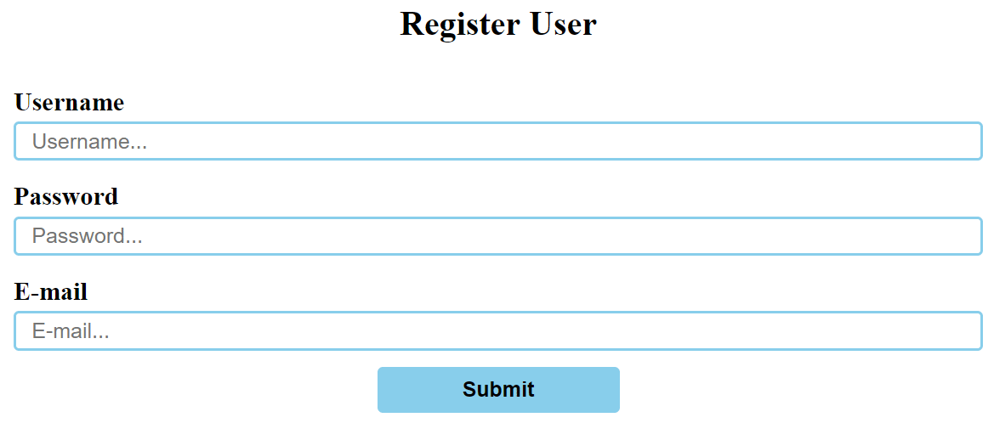
Form Validator (Demo) – Result
<body>
<form class="validator-form">
...
</form>
<script src="app.js"></script>
</body>
app.js
Don’t forget to import your JavaScript file
$.validate();
This plugin is attached directly to jQuery
Calling the validate() func. initiates the plugin functionality

Slide 21
Form Validator
Live Demo

Slide 22





Table Grid

Slide 23

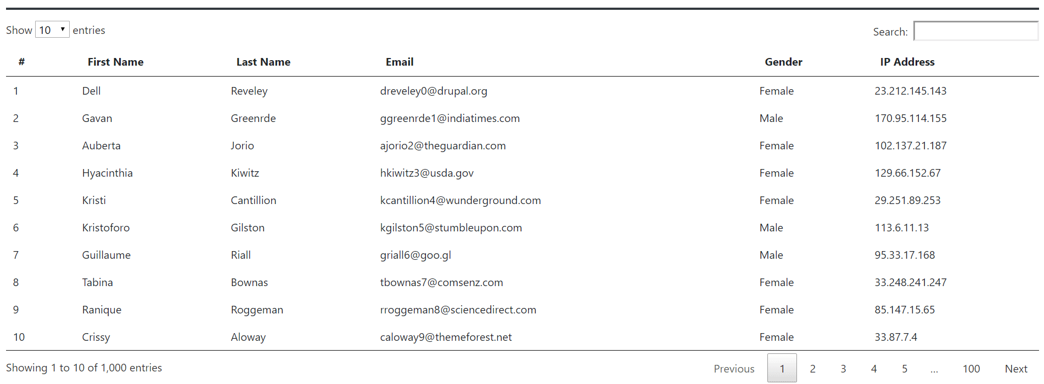
Table Grid
DataTables is a jQuery plugin that enhances HTML tables.
Highly flexible. Provides many extensions.
Build upon the foundations of progressive enhancement.
Documentation: https://datatables.net/

Slide 24
Table Grid (Demo)
The plugin CSS
<head>
...
<link rel="stylesheet" href="css/datatables.min.css">
<link rel="stylesheet" href="css/style.css">
<script src="lib/jquery-3.3.1.min.js"></script>
<script src="lib/datatables.min.js"></script>
</head>
JQuery & the plugin
Our Table
<body>
<table id="table-grid">
<thead>...</thead>
<tbody>...</tbody>
</table>
</body>

Slide 25
Table Grid (Demo)
...
<thead>
<tr>
<th scope="col">#</th>
<th scope="col">First Name</th>
<th scope="col">Last Name</th>
<th scope="col">Email</th>
<th scope="col">Gender</th>
<th scope="col">IP Address</th>
</tr>
</thead>
<tbody>
</tbody>
...
...
<thead>
</thead>
<tbody>
<tr>...</tr>
<tr>...</tr>
<tr>...</tr>
<tr>...</tr>
<tr>...</tr>
<tr>...</tr>
<tr>...</tr>
...
</tbody>
...
The table heading design
The table body design

Slide 26
Table Grid (Demo)
The table body inner rows design
...
<tbody>
<tr>
<td class="id">2</td>
<td class="first_name">Gavan</td>
<td class="last_name">Greenrde</td>
<td class="email">ggreenrde1@indiatimes.com</td>
<td class="gender">Male</td>
<td class="ip_address">170.95.114.155</td>
</tr>
...
</tbody>
</table>
<script src="app.js"></script>
Don’t forget to import your JavaScript file

Slide 27
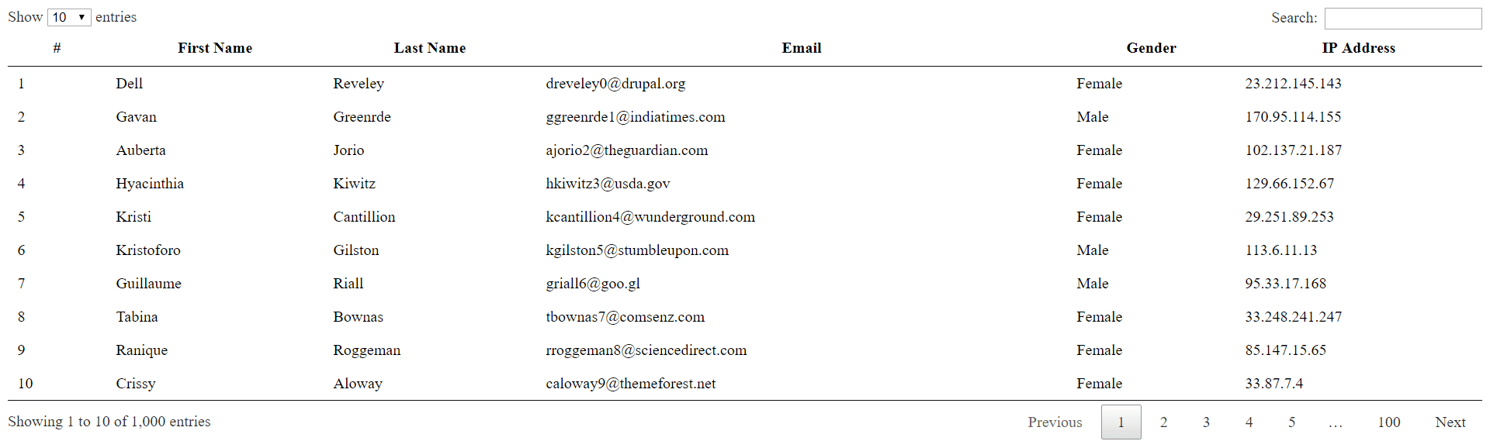
Table Grid (Results)
app.js
Select the element, using JQuery
Calling the dataTable() func. initiates the plugin functionality
$("#table-grid").dataTable();

Slide 28
Table Grid
Live Demo

Slide 29


Summary
jQuery comes with lot of plugins that increase website functionality
Slick Slider
Date & Time Picker
Form Validator
Table Grid
$('.slider').slick();
$('#producedOn').datetimepicker();
$.validate();
$("#table-grid").dataTable();

Slide 30







JavaScript for Front-End – JQuery Plugins
https://softuni.bg/courses/javascript-for-front-end

Slide 31






SoftUni Diamond Partners

Slide 32






SoftUni Diamond Partners

Slide 33

License
This course (slides, examples, demos, videos, homework, etc.) is licensed under the "Creative Commons Attribution-NonCommercial-ShareAlike 4.0 International" license

Slide 34





Trainings @ Software University (SoftUni)
Software University – High-Quality Education, Profession and Job for Software Developers
softuni.bg
Software University Foundation
http://softuni.foundation/
Software University @ Facebook
facebook.com/SoftwareUniversity
Software University Forums
forum.softuni.bg

